Slide 1
Gamma 4
Isomer, Widths, Energetics

Slide 2




























Slide 3






Slide 4







Slide 5







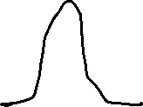






















Slide 6































Slide 7

























Slide 8

















Slide 9










Slide 10






Slide 11








Slide 12
















